Slide 1

The Aga Khan Hospital Dar es Salaam
Dr. Kigocha Okeng'o - OPA Documentation Compliance for Q4 2022

Slide 2
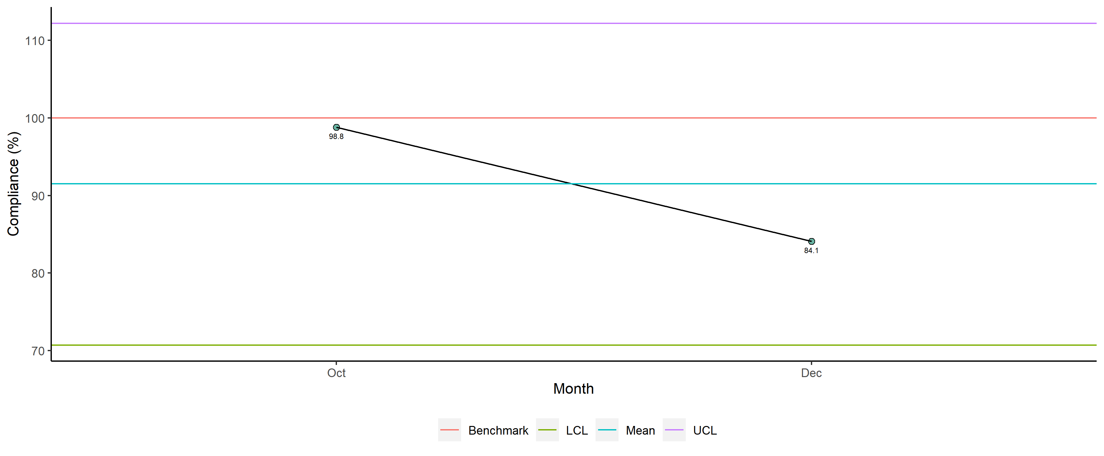
Dr. Kigocha Okeng'o - Availability of Required Documents

Slide 3
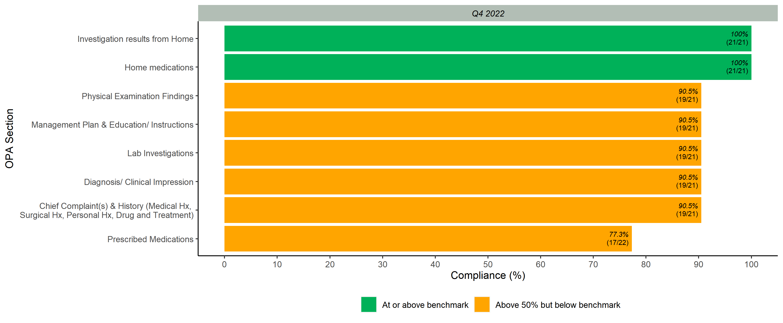
Documented Scores per OPA Section

Slide 4
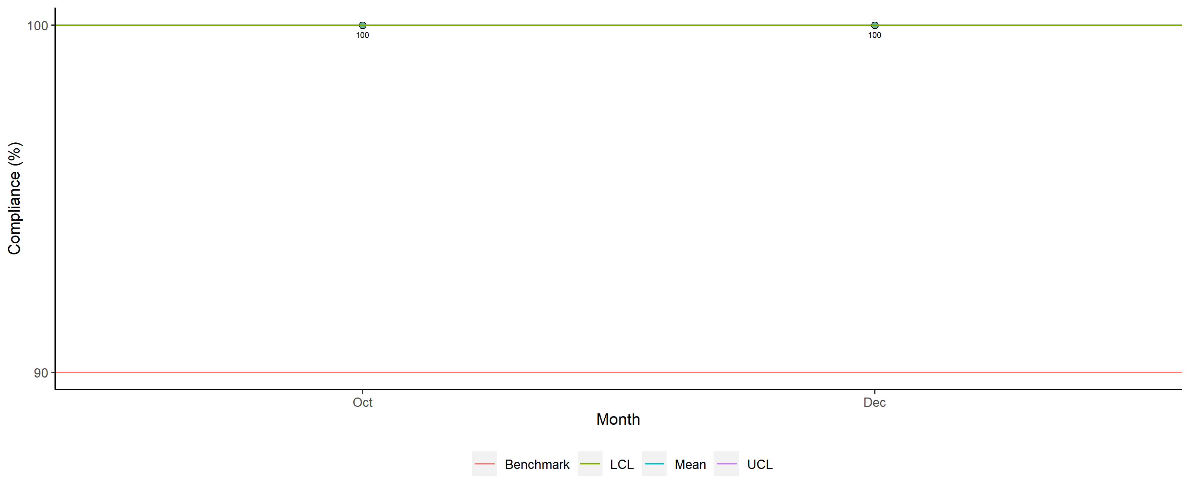
Dr. Kigocha Okeng'o - Legibility

Slide 5
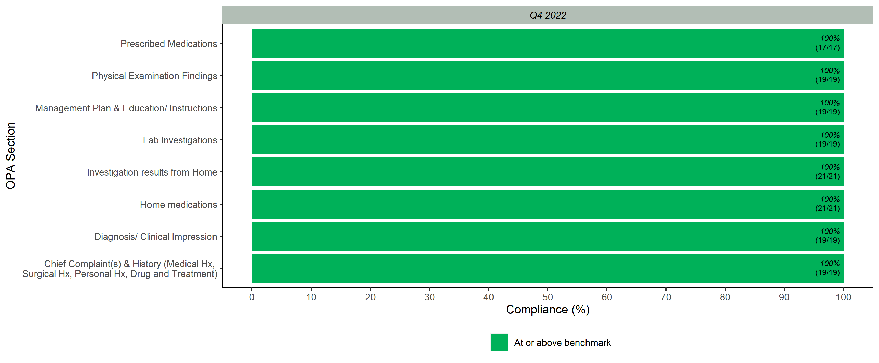
Legibility Scores per OPA Section

Slide 6
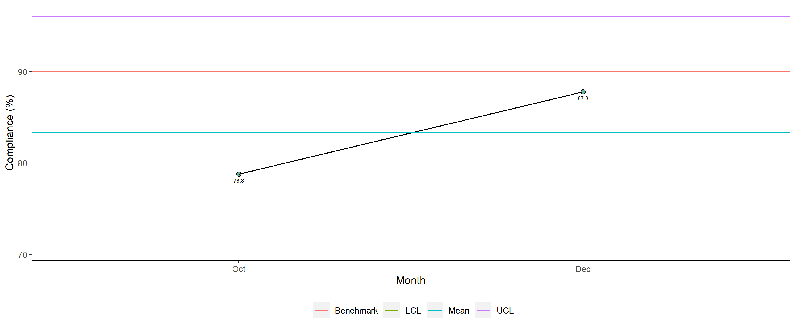
Dr. Kigocha Okeng'o - Completeness

Slide 7
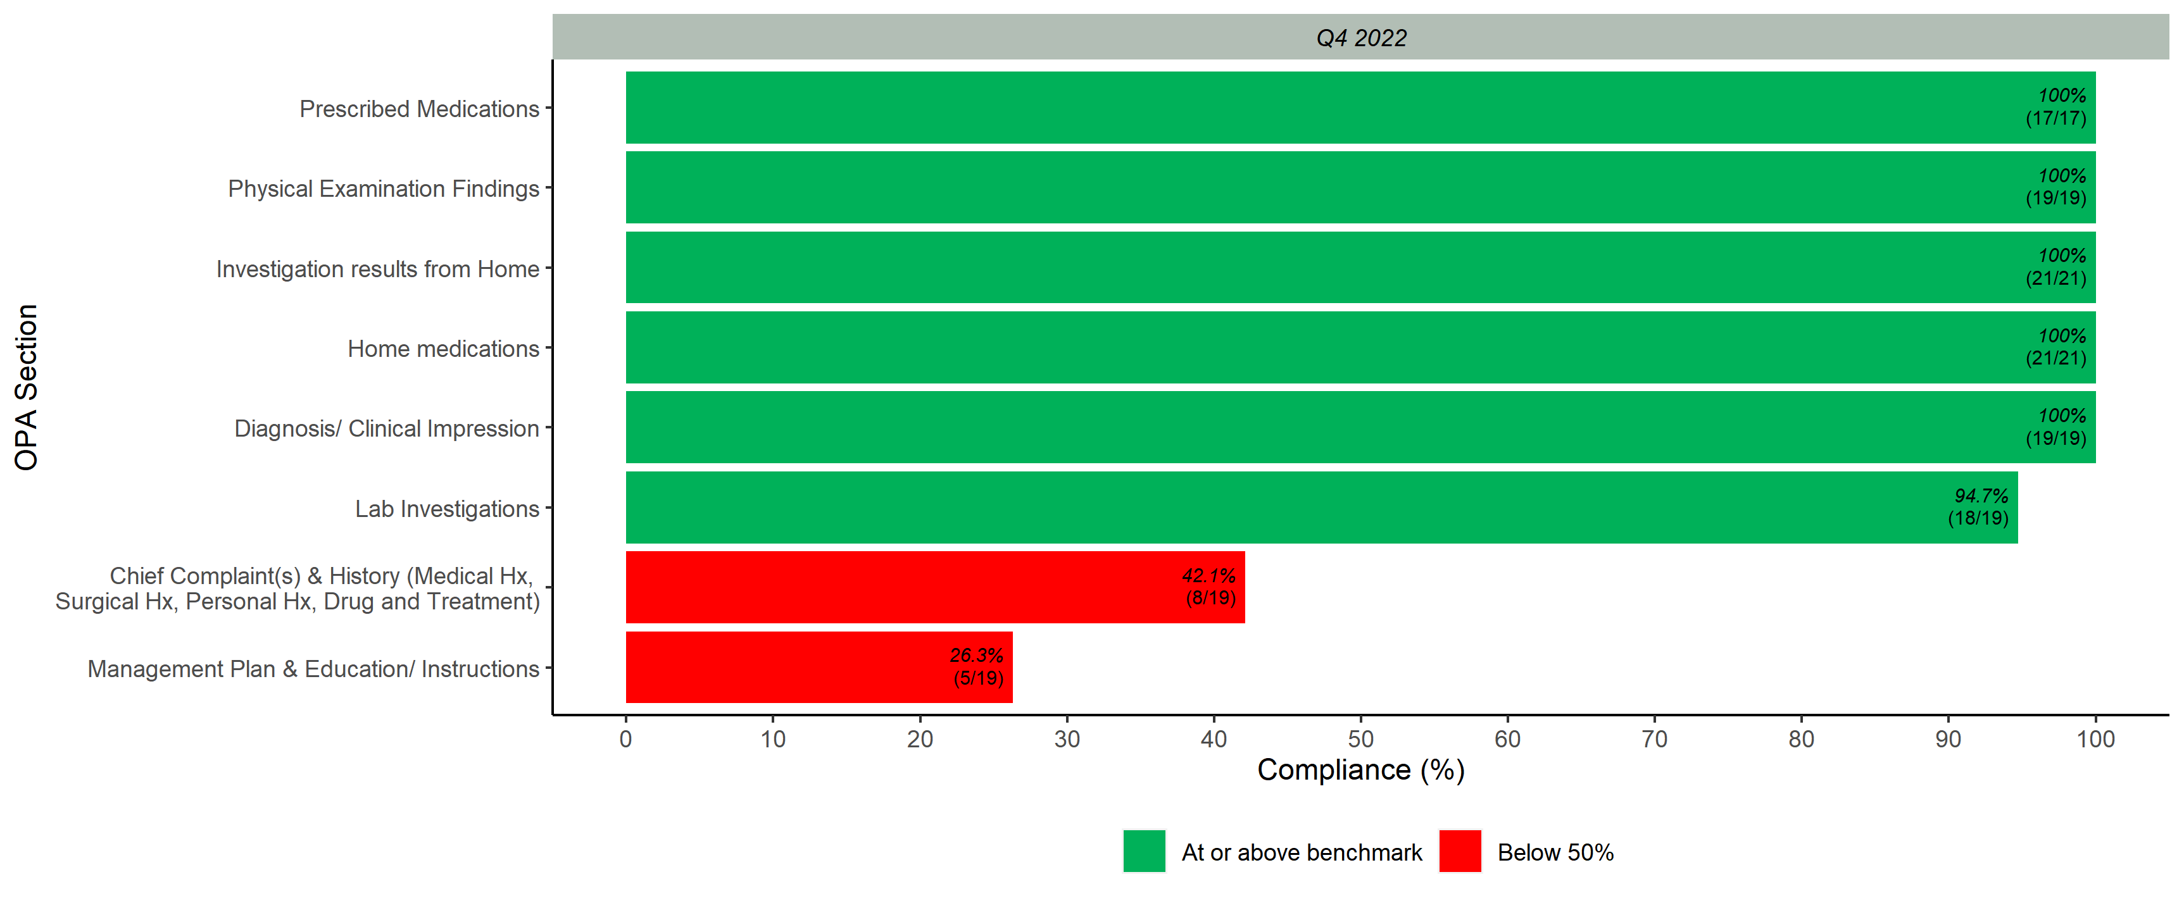
Completeness Scores per OPA Section

Slide 8
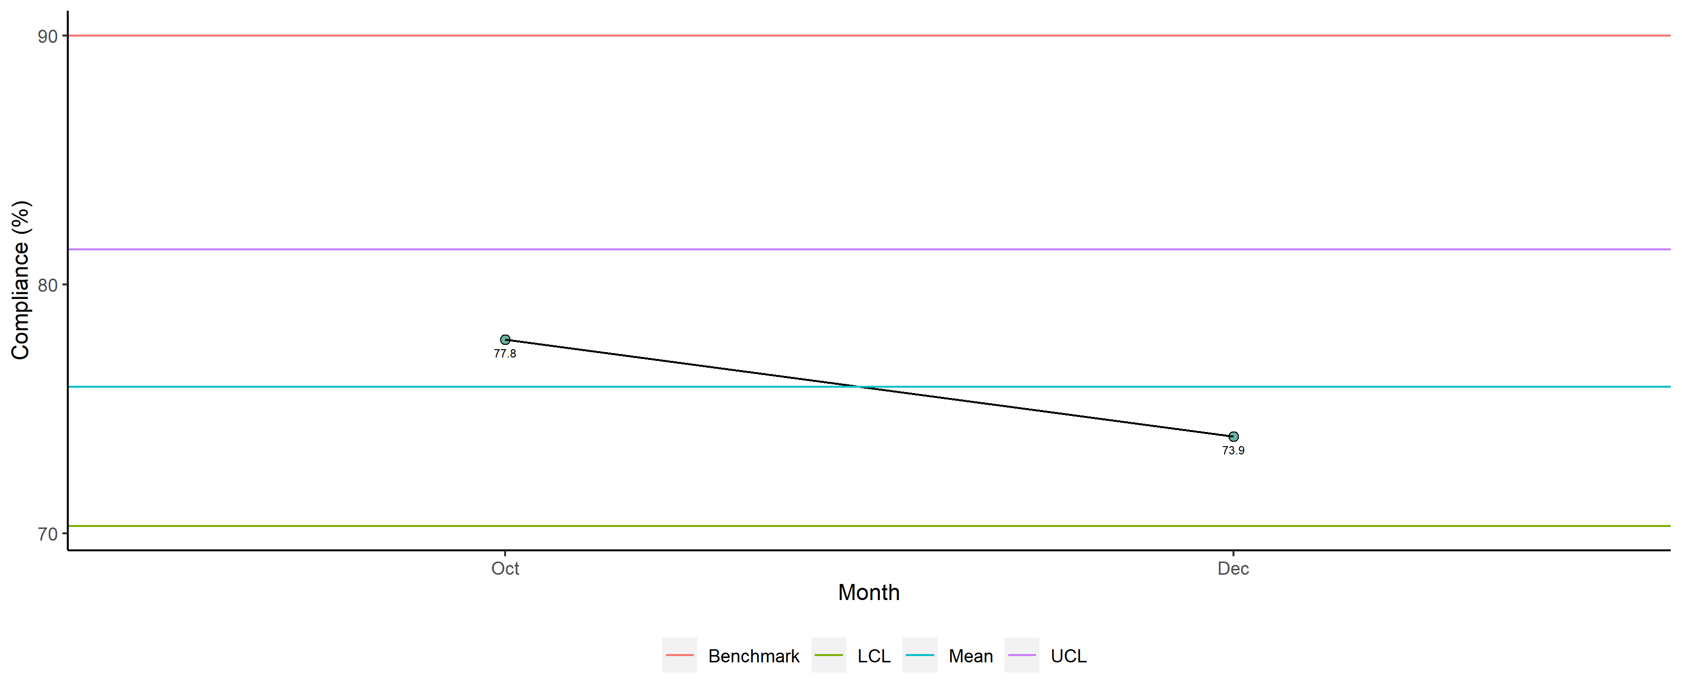
Dr. Kigocha Okeng'o - Overall

Slide 9
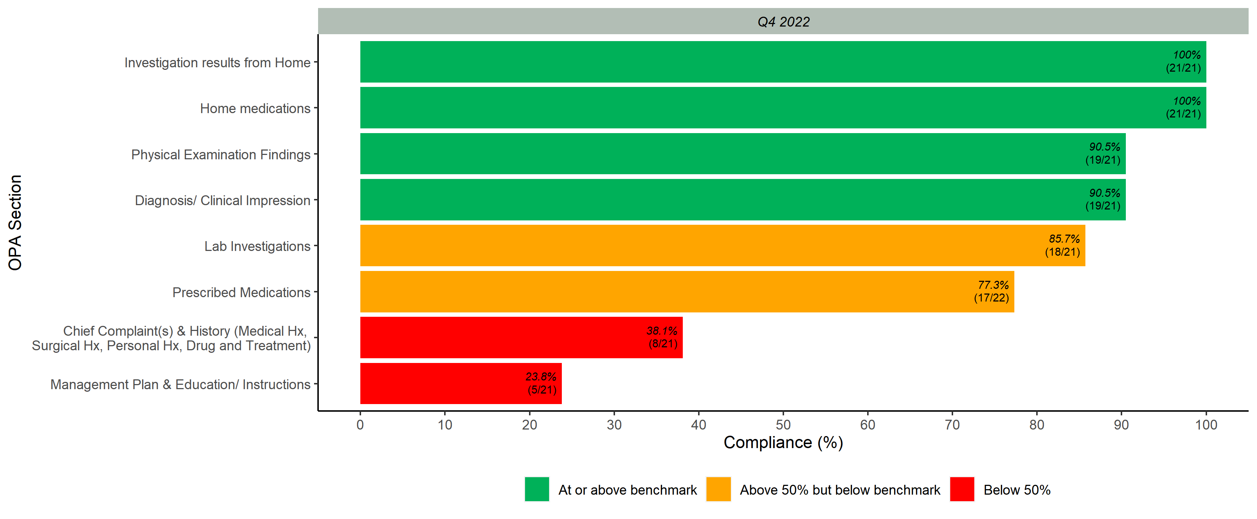
Overall Scores per OPA Section

